Slide 1


Pre-Op Assessment o Oncological Surgerie
Topics in Cardio- Oncology
Barry Trachtenberg MD
Director, Cardio-Oncology and Cardiac
Amyloidosis
Methodist DeBakey Heart and Vascular Center

Slide 2


OBJECTIVES
Review general principles of peri-operative risk
Review specific malignancies that are common and have unique CV risks
Review appropriate CV assessment

Slide 3

Risk of myocardial infarction and cardiac arrest (MICA)
Similar principles to general perioperative approach apply as to general population
General principal is that all patients with good functional capacity should proceed to surgery and coronary assessment should only be performed if the results would change management
For patients with recent MI, 2014 AHA/ACC guidelines recommend 3 month delay before stopping DAPT although anticipated updates may require only 1 month for newer DES
Several risk scores have been studied for risk MICA

Slide 4
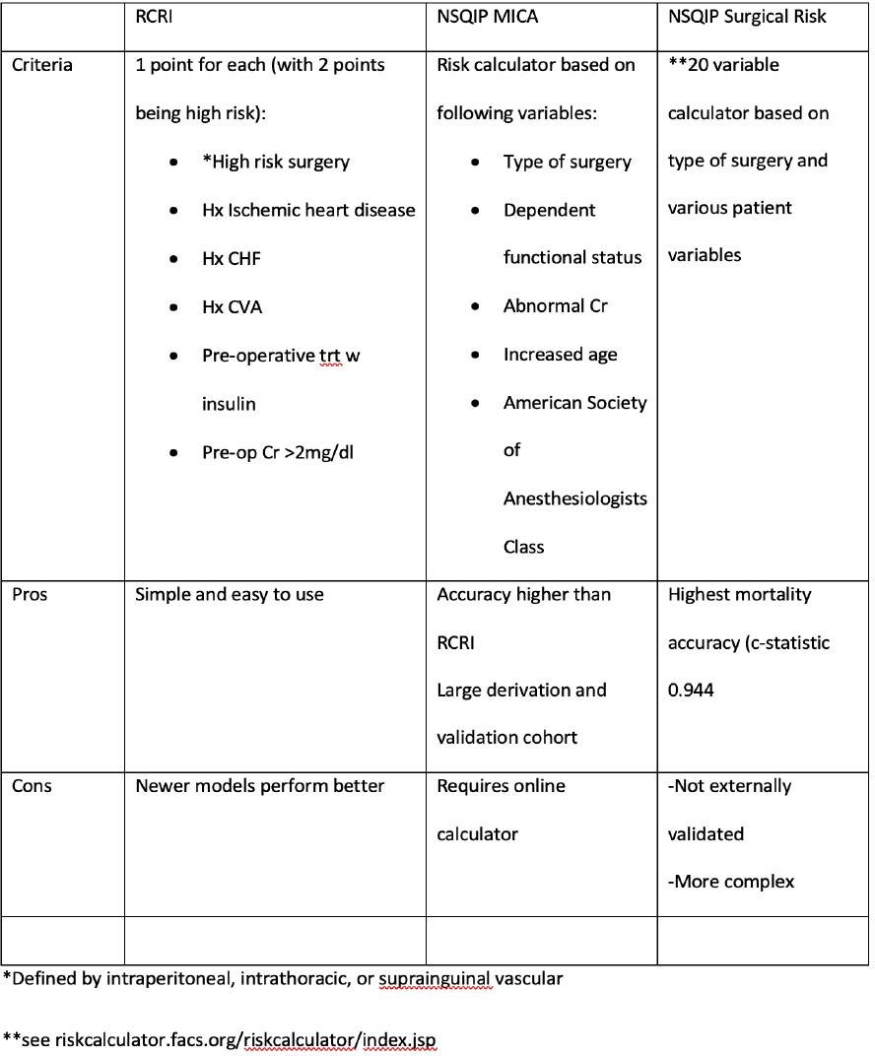

Patel AY et al JACC 2015
Bilimoria KY et al J Am Coll Surg 2013 Gupta PK et al Circulation 2011

Slide 5

Risk HF Decompensation
Symptomatic heart failure has the highest CV risk for patients undergoing surgery in general, while asymptomatic left ventricular dysfunction also carries an increased risk of CV morbidity and mortality compared to patients without heart failure or abnormal LV function
Assessment of LV function prior to surgery should be performed particularly in any patient who has been exposed to potentially cardiotoxic therapies including (but not limited to) anthracyclines, human epidermal growth factor receptor (her-2) antagonists, certain vascular endothelial growth factor (VEGF) inhibitors and tyrosine kinase inhibitors (TKI), and immunotherapies

Slide 6

BREAST CANCER
Majority of patients with Stage 1-3 breast cancer have surgical interventions as part of treatment plan
*Wound complications are most common complications and CV events are low (<1%)
Thus, pre-op CV assessment should occur for those who warrant evaluation independent of surgical consideration
Anthracyclines and her-2 antagonists are common and assessment of LV function(i.e. echo) should be considered prior to surgery
*El-Tamer et al Ann surg 2007
*De Blacam et al Ann Surg 2012

Slide 7
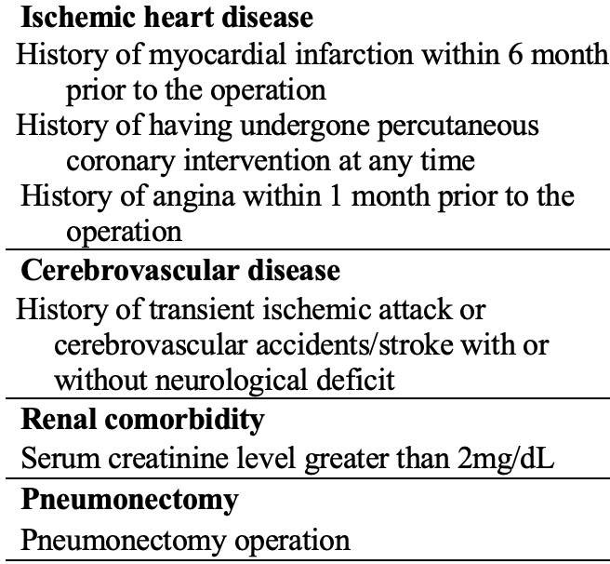
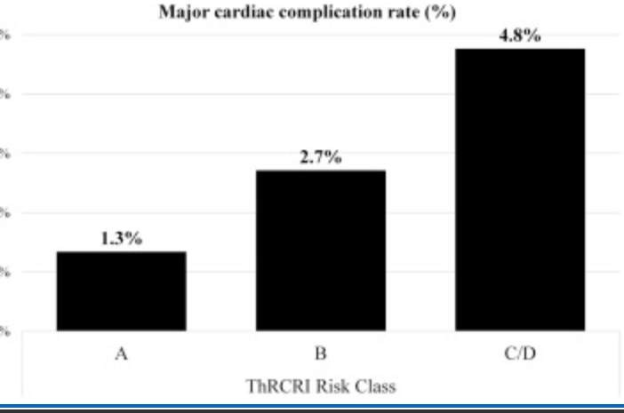

LUNG CANCER
69% of stage 1-2 patients undergo surgical trt
Cv morbidity higher due to older age and commonality of smoking history
An adaptation of RCRI, the Thoracic Revised Cardiac Risk index OR ThRCRI is predictive of CV risk in this population
Thomas DC Ann Tho Surg 2017

Slide 8

COLORECTAL CANCER
Risk MI peri-operatively for patients undergoing colorectal surgery
risk if advanced age, history HF, CKD, low albumin
In patients w HD, presence of ascites = 2x greater risk death
Moghadamyeghaneh et al Am Surg 2015 Zhang et al Int J Colorectal Dis 2017 Moghadamyeghaneh Am J Surg 2015
•

Slide 9

RISK AFIB/VTE
Many types of cancer portend increased risk CVE independent of atrial fibrillation due to hypercoaguable state
Atrial fibrillation particularly common in pts undergoing lung resection (12-13%) and also colectomy or esophageal resection
No evidence to support AAD prophylaxis,
Risk VTE in cancer patients 2x> than noncancer patients undergoing surgery
  Patient factors: age, obesity, prolonged hospital stay
  Cancer factors: low for breast (0.3%), high in esophagectomy (7.3%), cystectomy (4.9%), pancreatectomy (3.4%)
Timp et al Blood 2013
De Martino J Vasc Surg 2012

Slide 10

MALIGNANT PERICARDIAL EFFUSIONS
Etiology: metastatic cancers, treatment (e.g. checkpoint inhibitors), GVHD post stem cell treatment, etc
Recurrence rate 36-60% with pericardiocentesis alone and improved with prolonged drainage and with pericardial window (recurrence rate <20%)
Laham et ak Heart 1996
Tsang et al Mayo Clin Proc 2000

Slide 11



Needs surgical Treatment
Received Potentially Cardiotoxic Chemotherap y
Normal
Proceed
Perioperative Risk <1%
Risk of MI
Risk of HF
Assessment of LVEF
Abnormal
Proceed
Good functional capacity
Cancer
OHT/LVAD
Perioperative Risk >1%
HF Referral
Coronary assessment if will potentially change management
Poor functional capacity
Medical therapy
Advanced HF (Stage D)
Survivors
Palliative
Need CV Surgery
Abnormal
Cardiotoxic chemotherapy (especially anthracyclines)
Echo or CMRI to assess LV function, valve, pericardium
Coronary assessment (Consider Coronary CTA)
History of XRT to chest
Assessment of LVEF
Normal

Slide 12

SUMMARY
Same principals of ischemia assessment apply as in general population
Assessment of EF should be performed in patients with history of any potentially cardiotoxic treatment, including chemotherapy, immunotherapy, radiation therapy

