Slide 1
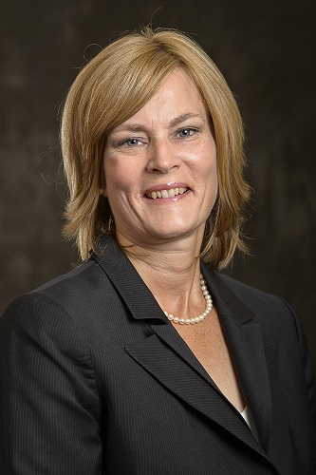
DR. SUSAN DENT Medical Oncologist The Ottawa Hospital
Medical Oncologist, The Ottawa Hospital Cancer Centre and Associate Professor, Department of Medicine, University of Ottawa.
MD from McMaster University and postgraduate training in Internal Medicine and Medical Oncology at the University of Ottawa.
Fellowship year in Clinical Research with the National Cancer Institute of Canada Clinical Trials Group.
Research lead for the breast disease site at the Ottawa Hospital Cancer Centre,
Member of the IND working group for the Breast Cancer Disease Site Committee of the National Cancer Institute for Canada Clinical Trials Group.
Research interests include breast cancer, and treatment related toxicities with a particular interest in cardiotoxicity.
Founder of the Ottawa Cardiac Oncology Program as well as the Canadian Cardiac Oncology Network (www.cardiaconcology.ca) , organizations dedicated to improving our understanding of how cancer treatments impact cardiovascular health with the ultimate goal of preventing cardiotoxicity.
72 articles published in peer reviewed journals
3 book chapters in Cardio-Oncology (in press)
Co-chair of the first Canadian Cardio-Oncology guideline and active participant in the recent ESC position statement on Cardio-Oncology
ASCO guideline on Survivorship and Cardiotoxicity (in press)
In September 2018, Dr. Dent accepted a staff position in medical oncology at Duke University, as Associate Director of Breast Cancer Clinical Research and Co-Director of the Duke Cardio-oncology program.
Dr. Dent is recognized as a global leader in breast cancer and cardio-oncology. She has travelled extensively around the world sharing her knowledge and expertise in breast cancer as well as the potential impact of cancer treatment on cardiovascular health.
She has published extensively in the area and has co-authored a number of position statements and clinical practice guidelines.
In 2015, Dr. Dent launched the Global Cardio-Oncology Summit (GCOS), an annual meeting which now attracts oncologists, cardiologists, and allied health care providers from more than 23 countries.

