Slide 1
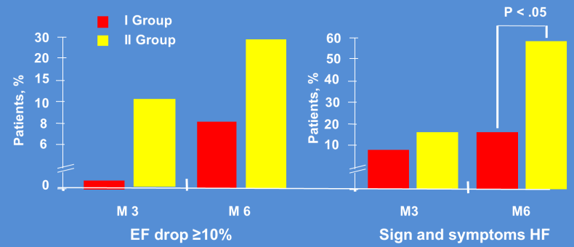
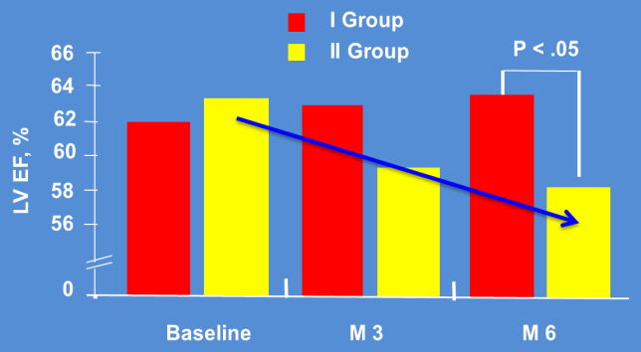
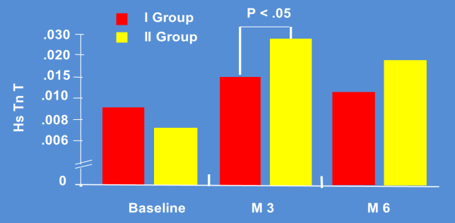
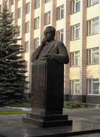
Predictive value of high-sensitive troponin T ratio in breast cancer treatment
Sergey Kozhukhov¹, Nataliia Dovganych¹, Ivan Smolanka², Olga Lygyrda²
¹ Cardio-Oncology Center, National Scientific Center “The M.D.Strazhesko Institute of Cardiology”, Kyiv, Ukraine
² Brest Cancer Department, Ukrainian National Cancer Institute, Kyiv, Ukraine
ABSTRACT
RESULTS
RESULTS
The utility of elevated troponin (Tn) as a marker of cardiotoxicity (CT) is well-established in cancer patients (pts). Obviously, pts with normal Tn during cancer therapy are excluded from cardiac monitoring programs. Therefore, cardiovascular (CV) complications in those pts may be underestimated.
Aim of the study was to test the hypothesis whether dynamic elevation of high sensitivity cardiac TnT (hs-cTnT) within upper limit of normal (ULN) associated with CT during breast cancer (BC) treatment.
Methods. This was a prospective observational study. 33 female pts (mean age 45±9 years) with newly diagnosed BC scheduled to anthracycline-based chemotherapy without history of CV diseases were included. Serum hs-cTnT was measured with immunoassay Roche Diagnostics (cut-off 0.03 ng/ml) in terms before, 3 and 6 month (M) of cancer treatment. Hs-cTnT ratio (∆hs-cTnT) was calculated by formula (max hs-cTnT−min hs-cTnT)/min hs-cTnT) between 3, 6 M and baseline. Pts were divided into two groups: 1st (13 pts) – with ∆hs-cTnT <100% and 2nd (20 pts) - with ∆hs-cTnT ≥100% within ULN. Clinical examination, ECG and transthoracic echocardiography with left ventricular ejection fraction (EF) evaluation were performed at the same visits. Data are presented as M±SD. Pearson's correlation analysis was used.
Results. Pts of both groups did not differ in age, baseline hs-cTnT and EF. At 3 M, pts of the 1st group had no incidence of CT (10% absolute drop in EF from baseline), and low incidence (1 pts) of heart failure (HF). At 6 M - 15% of pts had symptoms of HF, 1 patient - had CT. EF has not changed in terms of 3 and 6 M.
In contrast, at 3 M pts of the 2nd group had a tendency in EF decrease (59.8±4.4 vs 62.5±5.3%, p>0.05), 3 pts had HF and 2 pts – CT. During FU at 6 M, pts of the 2nd group demonstrated statistically significant EF reduction in compare to baseline (58.4±4.9 vs 62.5±5.3%, p<0.05), 30% of pts had CT and 60% - had HF symptoms. Direct correlation between ∆hs-cTnT and anthracycline's dose (r=0.50, р<0.05) was evaluated in pts of the 2nd group.
Conclusion. BC pts with ∆hs-cTnT ≥100% within ULN in 3 and 6 M had higher incidence of myocardial dysfunction and HF during cancer treatment. Ratio ∆hs-cTnT≥100% can be used as early biochemical marker of CT. Identification of these pts will facilitate evaluation of subsequent cardiotoxicity and prevent CV complications.
Pts of both groups did not differ in age, baseline hs-cTnT and EF. At 3 M, pts of the 1st group had no incidence of CT (10% absolute drop in EF from baseline), and low incidence (1 pt) of heart failure (HF). At 6 M - 15% of pts had symptoms of HF, 1 pt - had CT. EF has not changed in terms of 3 and 6 M.
In contrast, at 3 M pts of the 2nd group had a tendency in EF decrease (59.8±4.4 vs 62.5±5.3%, p>0.05), 3 pts had HF and 2 pts – CT. During FU at 6 M, pts of the 2nd group demonstrated statistically significant EF reduction in compare to baseline (58.4±4.9 vs 62.5±5.3%, p<0.05), 30% of pts had CT and 60% - had HF symptoms. Direct correlation between ∆hs-cTnT and anthracycline's dose (r=0.50, р<0.05) was evaluated in pts of the 2nd group.
PURPOSE AND OBJECTIVES
The utility of elevated troponin (Tn) as a marker of cardiotoxicity (CT) is well-established in cancer patients (pts). Obviously, pts with normal Tn during cancer therapy are excluded from cardiac monitoring programs. Therefore, cardiovascular (CV) complications in those pts may be underestimated.
Aim of the study was to test the hypothesis whether dynamic elevation of high sensitivity cardiac TnT (hs-cTnT) within upper limit of normal (ULN) associated with CT during breast cancer (BC) treatment.
DISCUSSION
The identification and management of BC pts at risk for CV has become critical in order to reduce morbidity and mortality due cardiovascular toxicity of cancer treatment, which negatively impact its effectiveness.
Detection of cardiotoxicity based on Tn elevation is recommended during cancer therapy with high doses of anthracyclines and trastuzumab.
In pts at low risk, for example without CV diseases or RF, scheduled to receive limited doses of anthracyclines cardiac monitoring with Tn use is not recommended routinely. However, elevation of high sensitivity cardiac TnT within normal range can identify cardiotoxicity at a preclinical phase and predict LV drop and future CV events in BC pts.
METHODS
This was a prospective observational study. 33 female pts (mean age 45±9 years) with newly diagnosed BC scheduled to anthracycline-based chemotherapy without history of CV diseases were included. Serum hs-cTnT was measured with immunoassay Roche Diagnostics (cut-off 0.03 ng/ml) in terms before, 3 and 6 month (M) of cancer treatment. Hs-cTnT ratio (∆hs-cTnT) was calculated by formula (max hs-cTnT−min hs-cTnT)/min hs-cTnT) between 3, 6 M and baseline. Pts were divided into two groups: 1st (13 pts) – with ∆hs-cTnT <100% and 2nd (20 pts) - with ∆hs-cTnT ≥100% within ULN. Clinical examination, ECG and transthoracic echocardiography with left ventricular ejection fraction (EF) evaluation were performed at the same visits. Data are presented as M±SD. Pearson's correlation analysis was used.
CONCLUSIONS
BC patients with ∆hs-cTnT ≥100% within ULN in 3 and 6 M had higher incidence of myocardial dysfunction and HF during cancer treatment. Ratio ∆hs-cTnT≥100% can be used as early biochemical marker of CT.
Identification of these patients will facilitate evaluation of subsequent cardiotoxicity and prevent CV complications.
REFERENCES
Cardinale D. et al. Prognostic Value of Troponin I in Cardiac Risk Stratification of Cancer Patients Undergoing High-Dose Chemotherapy. Circ. 2004. 109(22), 2749-2754
Cardinale D. et al. Myocardial injury revealed by plasma troponin I in breast cancer treated with high-dose chemotherapy. Annals of Oncology 13: 710–715, 2002
Mallouppas M. et al. Troponin trends during anthracycline chemotherapy and their correlation with cardiovascular risk score. Eur Heart J, 41, Sup_2, ehaa946.3283
Pudil R et al. Role of serum biomarkers in cancer patients receiving cardiotoxic cancer therapies: a position statement from the Cardio-Oncology Study Group of the HFA and the Cardio-Oncology Council of the ESC. Eur J of Heart Fail (2020) 22, 1966–1983
This presentation is the intellectual property of the author.
Contact at .s.kozhukhov@i.ua for permission to reprint and/or distribute.
Declaration of interest: nothing to declare.

