Slide 1
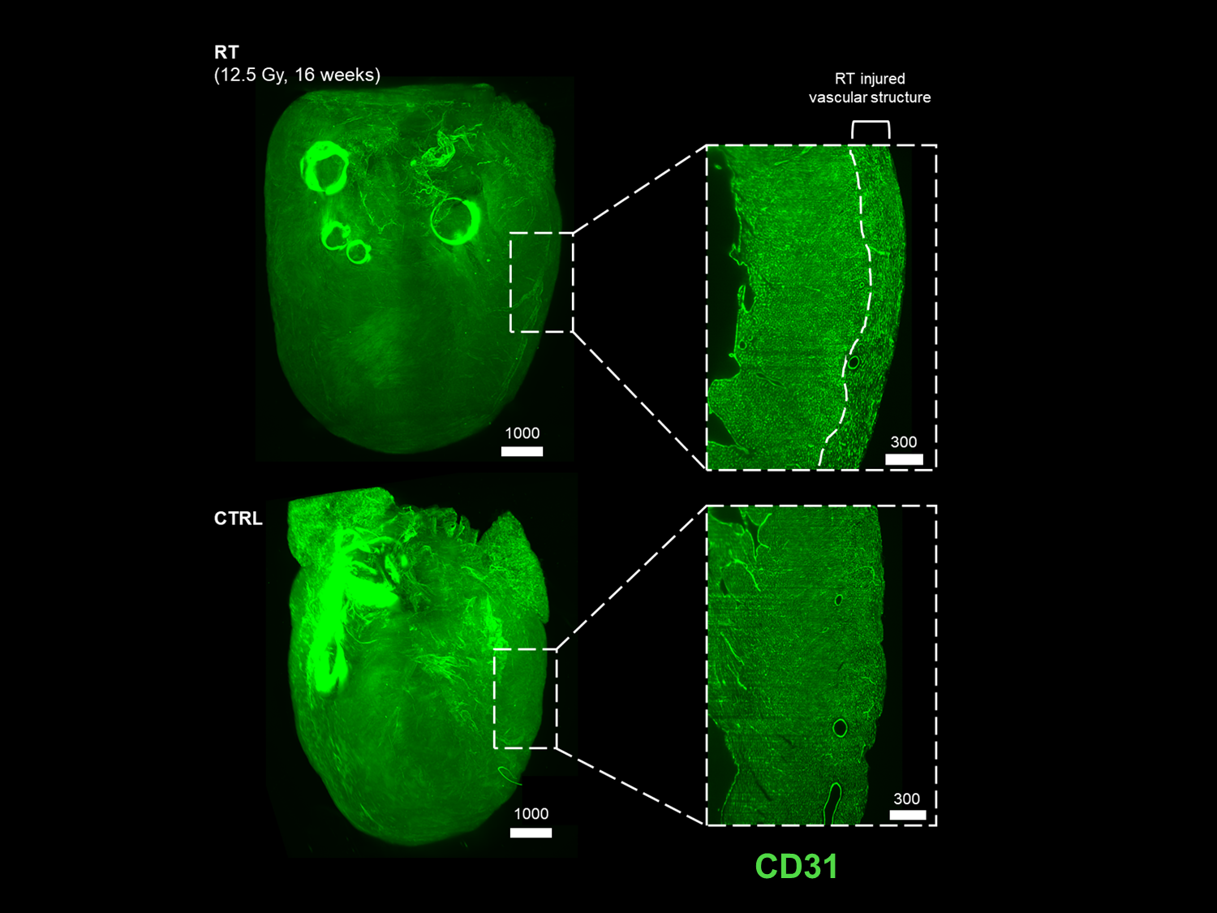
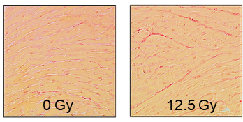
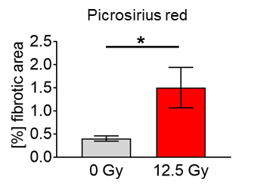
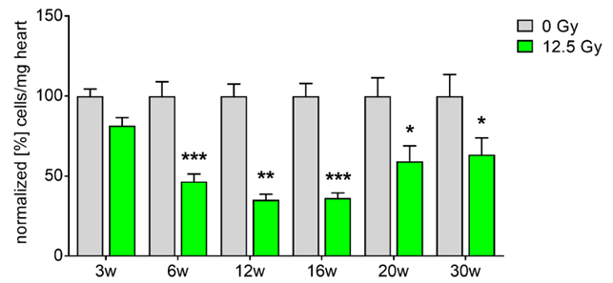
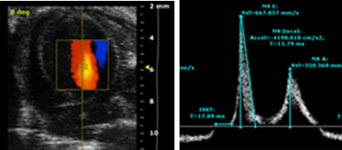
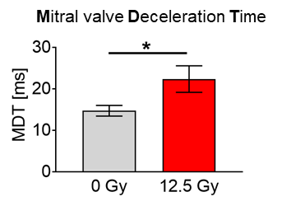
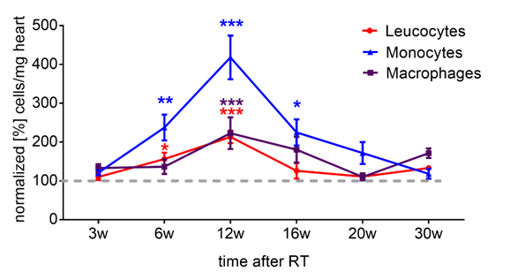
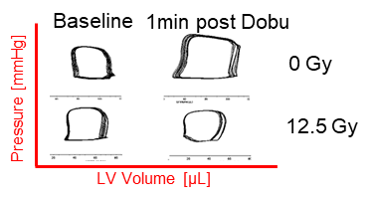
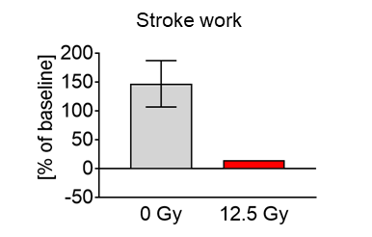
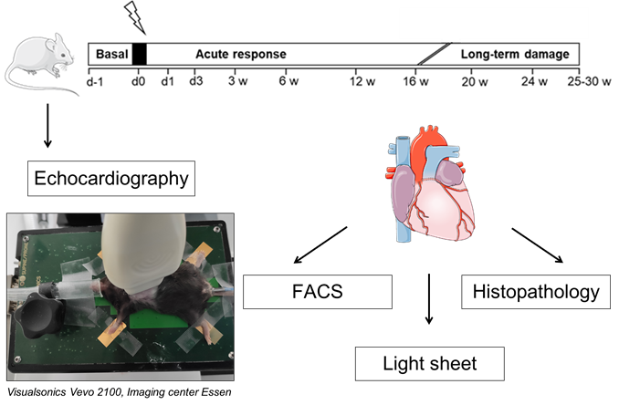
Thoracic irradiation leads to endothelial damage and differential immune response in mice
Simone M. Mrotzek1, Florian Wirsdörfer2, Sebastian Korste1, Lars Michel1, Lena Gockeln2, Ulrike Hendgen-Cotta1,
Verena Jendrossek2, Tienush Rassaf1, Matthias Totzeck1
1Department of Cardiology and Vascular Medicine, West German Heart and Vascular Center, Medical Faculty, University Hospital Essen, Hufelandstr. 55, 45147 Essen
2Institute of Cell Biology (Cancer Research), University Hospital Essen
Background
Results
C) Long-term damage
A) Endothelial damage
Cardiac fibrosis
Cardio-Oncology
CD31 expression
Chest irradiation is associated with multiple cardiovascular diseases in cancer patients occurring years after cancer therapy which are therefore difficult to treat and diagnose.
Diastolic dysfunction
Objectives
time after RT
To characterize the development of radiation-induced cardiomyopathy and elucidate underlying patho-mechanisms.
Methods
B) Differential immune response
Reduced contractile reserve
Conclusion/ Outlook
The established mouse model presents new starting points for therapeutic strategies to reduce radiation-induced cardiac damage.
This presentation is the intellectual property of the author. Contact at simone.mrotzek@uk-essen for permission to reprint and/or distribute.

