Slide 1
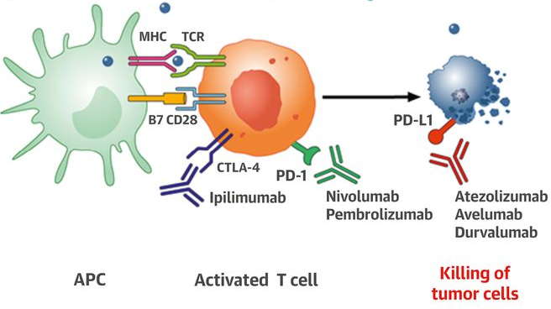
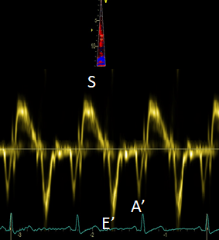
University Hospital Essen
West German Heart and Vascular Center
Department of Cardiology and Vascular Medicine
Left ventricular global longitudinal strain reduction in patients with melanoma and
extracardiac immune-related adverse events during immune checkpoint inhibitor therapy
Raluca I. Mincu¹; Julia Pohl¹; Simone Mrotzek¹; Lars Michel¹; Lena Hinrichs¹; Lena Lampe¹; Tienush Rassaf¹; Matthias Totzeck¹
¹Department of Cardiology and Vascular Medicine, West German Heart and Vascular Center, Medical Faculty, University Hospital Essen, Hufelandstraße 55, 45147 Essen, Germany
Background
Results
Results
Immune checkpoint inhibitors (ICI) have increased survival in patients with melanoma.
By unbalancing the immune system, ICI also generate immune-related adverse events (IRAEs) that could affect any tissue, including the heart.
Early detection of IRAEs under ICI therapy is essential to avoid life-threatening adverse events like myocarditis and to maintain patients under the ICI therapy.
Mechanism of action of ICI therapy
A) Patient characteristics
Patients in Group 1 with extracardiac IRAEs had a significant reduction of LV global longitudinal strain (GLS) at follow-up (left graph).
Patients in Group 2 without extracardiac IRAEs did not show a LV GLS reduction at follow-up (right graph).
Parameter | Group 1 (n = 22) Patients with IRAEs | Group 2 (n = 46) Patients without IRAEs | p value
Age (years) | 63 ± 9 | 56 ± 14 | 0.19
Male (%) | 45 | 66 | 0.26
Arterial hypertension (%) | 45.5 | 47.6 | 0.91
Diabetes mellitus (%) | 9.1 | 4.8 | 0.64
Dyslipidemia (%) | 9.1 | 14 | 0.68
Smoking (%) | 9.1 | 19 | 0.47
Metastatic disease (%) | 90.9 | 95.2 | 0.64
Combination therapy (%) | 72.7 | 33.3 | 0.04
Checkpoint inhibitors stimulate T-cell activation. Monoclonal antibodies targeting CTLA-4 (ipilimumab), PD-1 (nivolumab, pembrolizumab), and PD-L1 (atezolizumab, avelumab, durvalumab) block immune inhibitory checkpoints (CTLA-4, PD-1, and PD-L1, respectively) and restore antitumor immune response, resulting in tumor cell death via release of cytolytic molecules.
Varricchi et al. Circulation 2017
Aim
Patients in Group 1 developed the following extracardiac IRAEs: colitis (n=10), thyroiditis/hypophysitis (n=8), hepatitis (n=2), and pneumonitis (n=2). Two patients developed immune related myocarditis and were excluded from the final analysis. Patients with combination ICI therapy had a 5 times higher risk to develop extra-cardiac IRAEs (OR 5.33, 95% CI (1.07-26.61), p = 0.04).
C) LV diastolic function parameter were similar at baseline a follow-up between the two groups
To determine whether patients treated with ICI that develop extra-cardiac IRAEs additionally show a subclinical impairment of the heart function.
Parameter | Group 1 (n = 22) Patients with IRAEs | Group 2 (n = 46) Patients without IRAEs | p value
Baseline E/A | 1 ± 0.3 | 1.1 ± 0.4 | 0.07
Follow-up E/A | 1 ± 0.2 | 1.2 ± 0.4 | 0.25
Baseline DT (ms) | 235 ± 70 | 197.8 ± 35.1 | 0.06
Follow-up DT (ms) | 198.25 ± 58.9 | 196.2 ± 54.5 | 0.93
Baseline E/E‘ | 7.5 ± 5.8 | 7 ± 2.4 | 0.66
Follow-up E/E‘ | 7 ± 1.5 | 6.7 ± 1.7 | 0.60
Baseline LA Strain (%) | -10.5 ± 2.9 | -12.2 ± 2.8 | 0.15
Follow-up LA Strain (%) | -8.1 ± 2.2 | -10.6 ± 3.8 | 0.051
Methods
B) LV systolic function parameter were similar at baseline and follow-up between the two groups, except for the LV global longitudinal strain (GLS).
Patients with stage III and IV melanoma without established cardiac disease were evaluated in our cardio-oncology unit between July 2018 and December 2019.
Baseline < 30 days
Follow-up = 30 days
Parameter | Group 1 (n = 22) Patients with IRAE | Group 2 (n = 46) Patients without IRAE | p value
Baseline 2D LVEF (%) | 60.9 ± 5.4 | 58.9 ± 6.1 | 0.34
Follow-up 2D LVEF (%) | 58.2 ± 5 | 58.2 ± 6.3 | 0.78
Baseline 3D LVEF (%) | 61.6 ± 5.4 | 59.7 ± 6.1 | 0.51
Follow-up 3D LVEF (%) | 58.5 ± 3.5 | 61.9 ± 5.8 | 0.16
Baseline GLS (%) | -22 ± 1.8 | -21.4 ± 2.1 | 0.39
Follow-up GLS (%) | -18.8 ± 2.6 | -21 ± 1.2 | 0.03
Baseline GCS (%) | -28.5 ± 7 | -29.8 ± 5.8 | 0.65
Follow-up GCS (%) | -25 ± 4.8 | -31.3 ± 7.7 | 0.05
Baseline GRS (%) | 62.2 ± 14.5 | 63.4 ± 10.3 | 0.82
Follow-up GRS (%) | 50.46 ±14 | 62.5 ± 12.5 | 0.05
E = early diastolic velocity; A = late diastolic velocity; DT = deceleration time; E’ = lateral mitral ring movement using Tissue Doppler Imaging; LA = left atria.
ICI therapy start
Conclusion
The abnormal function of the immune system triggered by ICI therapy in patients with extra-cardiac IRAEs seems to induce a subclinical left ventricular dysfunction, signalized by a reduction of the GLS. However, the diagnosis criteria for myocarditis could be fulfilled in only two patients. The mechanism of these changes needs to be further investigated and addressed.
Tridimensional echocardiography
Global longitudinal strain analysis
Tissue Doppler echocardiography
2D LVEF = bidimensional left ventricular ejection fraction; 3D LVEF = tridimensional left ventricular ejection fraction; GLS = global longitudinal strain; GCS = global circumferential strain; GRS = global radial strain.

