Slide 1
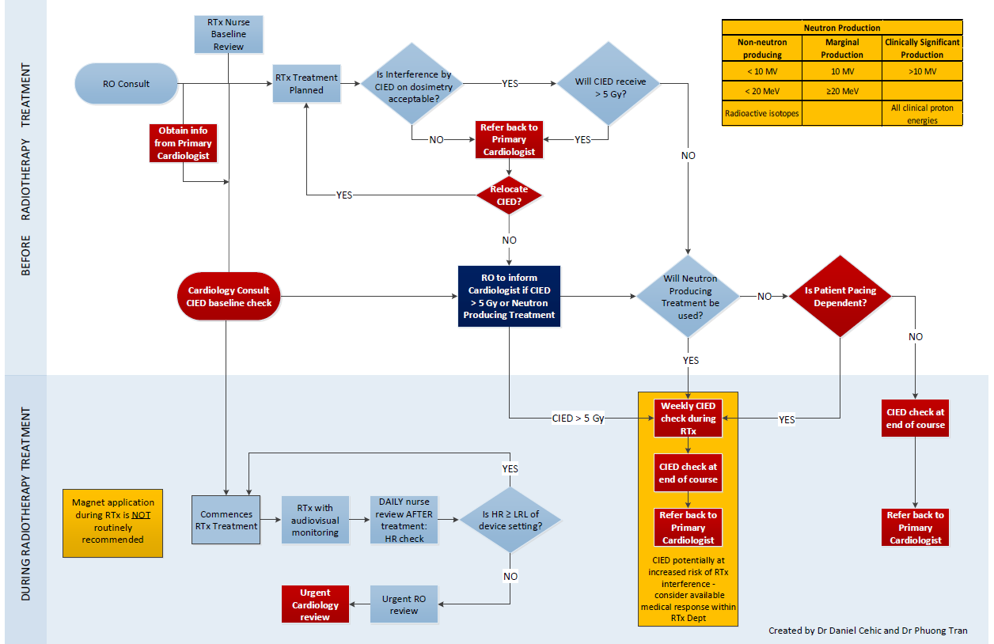
Safe Delivery of Radiotherapy in Patients with Cancer and CIEDs Cehic Danielª, Eckert Marion^{b}, Corsini Nadia^{b}, Sharplin Greg^{b}, Tran Phuongª a. GenesisCare Sydney Australia b. Rosemary Bryant Research Centre, University of South Australia, Adelaide Australia
Background
Results
Radiotherapy is an important part of cancer treatment and approximately 50% of all cancer patients will receive it. Many of these patients will have a Cardiac Implantable Electronic Device (CIED). Ionising radiation may result in temporary or permanent dysfunction of the CIED. A Heart Rhythm Society (HRS) expert consensus statement on radiation exposure in patients with CIEDs has helped clarify modern management of these patients (1).
Patients had a variety of device manufacturers and types of CIEDs and those devices had varying levels of ionising radiation exposure (all were non-neutron producing) as per the table below. Generally ionising radiation could be kept to acceptable limits but even when there was a large dose delivered to the CIED, there was no evidence of CIED malfunction during or after radiotherapy in any of the patients.
Methods
We developed a patient management pathway based on the HRS expert consensus statement for patients with CIEDs undergoing radiotherapy. Patients were seen pre-treatment and then during and/or after treatment as per the pathway. We prospectively collected radiation and device data on the first 100 consecutive cases managed by this pathway at GenesisCare in Adelaide, Australia.
 | Number |  | Number |  | Number
Sorin | 1 | ICD | 14 | PM | 86
Biotronik | 6
Boston Scientific | 8 |  | Dose |  | Dose
Abbott | 30 | Mean (Gy) | 4.4 | Mean (Gy) | 0.9
Medtronic | 55 | Range (Gy) | 0 - 50.6 | Range (Gy) | 0 - 31.3
Conclusions
Following a management pathway based on the most recent HRS guidelines is a practical workable method to ensure safe and timely treatment of patients with CIEDs and cancer with radiotherapy. Modern CIEDs appear more resilient to ionising radiation than historical studies would seem to suggest.
References
Indik JH, Gimbel JR, Abe H, Alkmim-Teixeira R, Birgersdotter-Green U, Clarke GD, et al. 2017 HRS expert consensus statement on magnetic resonance imaging and radiation exposure in patients with cardiovascular implantable electronic devices. Heart Rhythm. 2017;14(7):e97-e153.
This presentation is the intellectual property of the author. Contact daniel.cehic@genesiscare.com for permission to reprint and/or distribute.
1
©GenesisCare 2021

