Slide 1
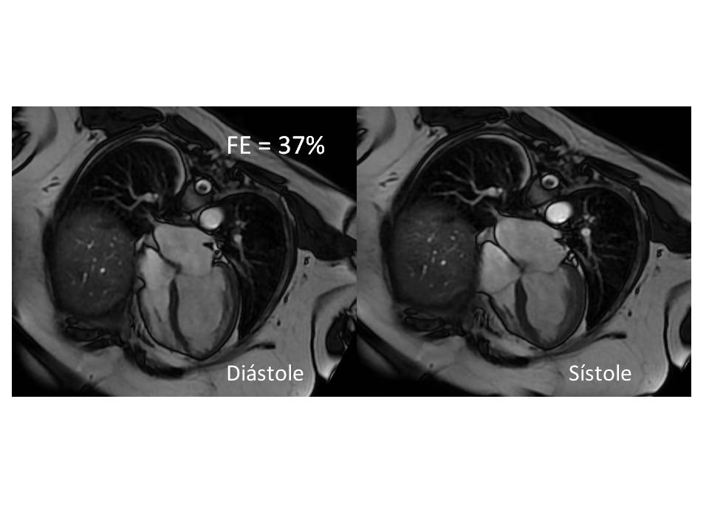
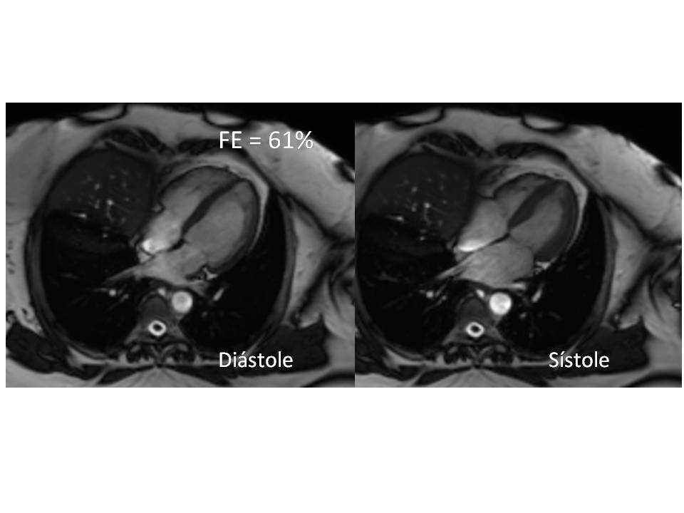
Successful drug rechallenge after osimertinib-related acute cardiac failure
Marina Macedo Kuenzer Bond, José Ecio Batista Rosado Jr, José Eduardo M. Barbosa, , Waldinai P. Ferreira, Júlio Cesar Santin, Carlos G. de Paula Jr, Humberto João Rigon Jr, Helano Carioca Freitas
A.C. Camargo Cancer Center – São Paulo, Brazil
Background: Some studies demonstrated that Osimertinib was related to heart failure (HF). It was also evidenced, through follow-up echocardiography, that after cessation of the medication, there was an improvement in the left ventricular ejection fraction (LVEF) of these patients. But the reintroduction of medication is controversial.
Case: 69-year-old patient, hypertensive, diabetic and dyslipidemic. with a previous history of metastatic colon adenocardinoma to the liver, treated with surgery and FOLFOX in 2008, she was diagnosed in 2012 with lung adenocarcinoma and underwent surgery. In May 2019 it evolved with the appearance of secondary bone lesions, treated with 3D radiotherapy 30Gy. A genetic panel was performed, EGFR del 19 and PIK3CA (E545K) mutations were detected. In September 2019 she started therapy with Osimertinib (80mg/day). In June 2020, he presented respiratory distress and orthopnea. A echocardiogram was performed which found moderate global systolic dysfunction, with a LVEF of 40%. Myocardial Resonance, confirme LVEF 37%. The absence of previous cardiovascular events, and secondary causes for the condition, Osimertinib was suspended, and cardiotoxicity being the main etiological hypothesis.
Two months after, with therapeutic HF optimization (carvedilol 50mg/day; enalapril 40mg/day, spironolactone 25mg/day; dapagliflozin 10mg/day; metformin XR 2g/day; rosuvastatin 20mg/day); there was complete recovery of cardiac function, with a new echocardiogram showing LVEF 55% and resonance with LVEF 61%. Due to the clinical resolution of HF, on December 9, 2020, the patient returned to use Osimertinib (80mg/day), maintaining cardioprotective treatment in an optimized dose, and cardio-oncological follow-up. Echocardiographic follow-up was performed on January and April, 2021 which showed LVEF maintenance of 64%, with asymptomatic patient.
Discussion: The use of osimertinib was related to HF. So, as we understand the adverse cardiovascular effects better, we are able to use appropriate cardioprotective therapy and avoid serious clinical outcomes that limit the use of this medication. In addition, we can consider the reintroduction of medication as we have more control over the risk of cardiac decompensation.
Fig1. Sequence image of cine-SSFP in a four-chamber plane taken on 06/19/2020 with a drop in LVEF.
Fig2. Sequence image of cine-SSFP in a four-chamber plane performed on 10/30/2020 demonstrating a normal LVEF.

