Slide 1
Advanced Imaging in Cardio-Oncology
The International Cardio-Oncology Society
IC-OS.org
Vera Vaz Ferreira
Notes:
Hello, my name is Vera Ferreira and today I am going to give a brief introduction about some Advanced Imaging techniques in Cardio-Oncology

Slide 2
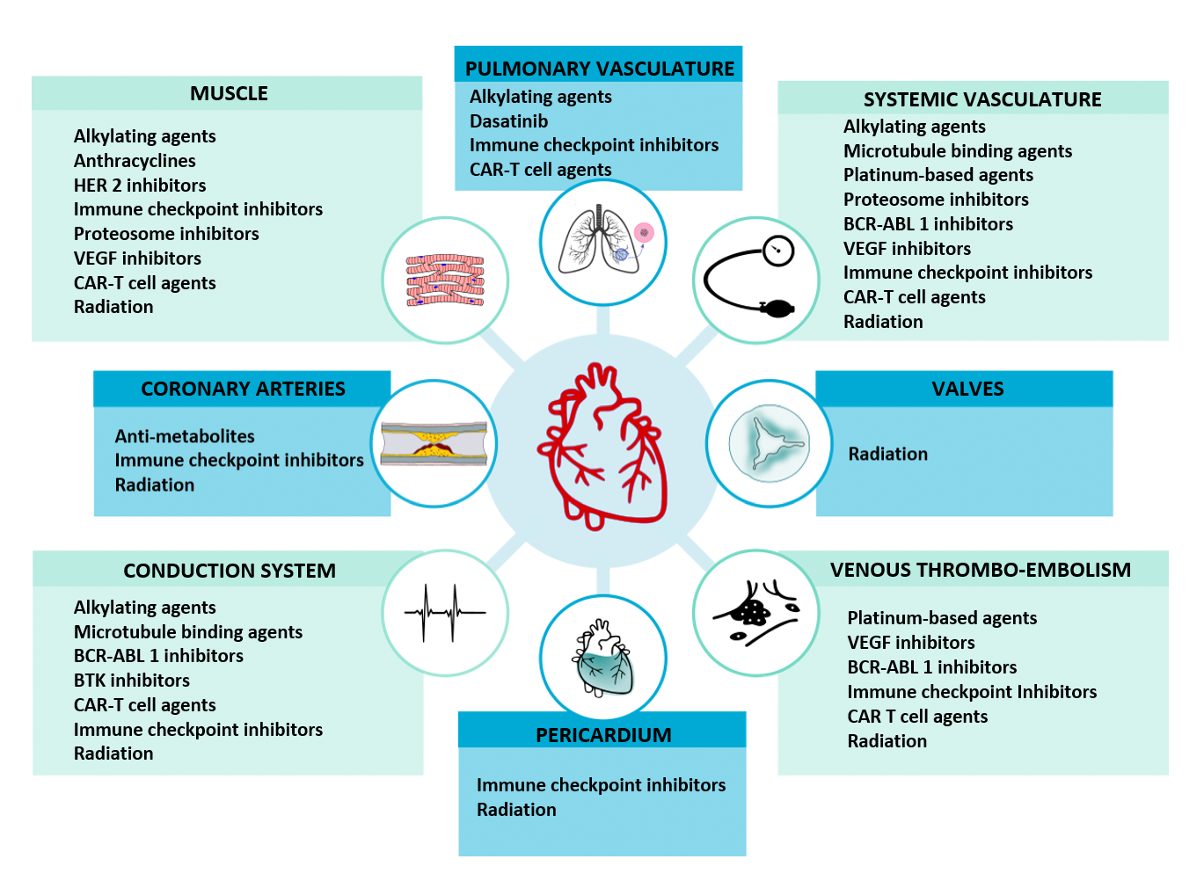
Cardiovascular Toxicity
Notes:
In the last few years, there has been a paradigm shift in the trajectory of the cancer patient with the appearance of new therapies.
Toxic effects of antineoplastic therapies, whether chemotherapy, targeted agents, immune therapies, radiation therapy or any combination of agents, can affect all CV structures.
Multimodality imaging includes assessment and monitoring of a range of CV toxicities, such as left ventricular (LV) dysfunction, vascular toxicity, myocarditis, atherosclerotic cardiovascular disease (ASCVD), valvular disease, and cardiac masses.

Slide 3
Stages of Imaging Evaluation
Baseline evaluation | During treatment |  | End-treatment long-term surveillance
Risk stratification | Early detection of injury | Prediction of recovery | Detection of injury in the survivors
Plana JC et al, JACC Cardiovasc Imaging. 2018
Notes:
Imaging can be used to risk-stratify patients, identify cardiovascular injury during therapy and after therapy in the high-risk patients. Baseline assessment of LV function, to detect unrecognized cardiac dysfunction. It should be performed in all patients scheduled for potentially cardiotoxic therapy. The same imaging modality should ideally be used during treatment and follow-up so that variability is kept as low as possible between studies.

Slide 4
Multimodality Imaging
Transthoracic 2D and 3D
Speckle tracking imaging
Myocardial deformation
Transesophageal
Structure and function
Parametric mapping
LGE
Perfusion
Cardiac Magnetic Resonance
(CMR)
Echocardiography
Cardiac CT
Nuclear Imaging
CT coronary angiography
CT chest
PET
SPECT
Notes:
Echocardiography, cardiac MR, CT and nuclear medicine studies form the imaging strategy. Echo is easily available. CMR is limited by availability and cost. CT is exquisite in its ability to evaluate the coronary arteries. PET is suitable for metabolic imaging and cardiac tumors. SPECT has an established role in ischemia imaging.

Slide 5
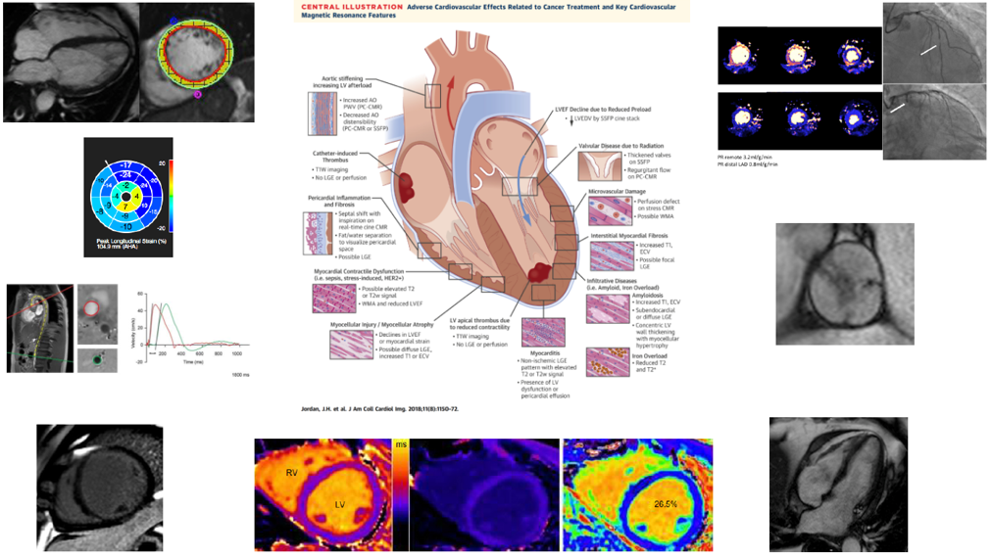
Cardiac Magnetic Resonance
Function
Cine imaging: volumes, ejection fraction and mass quantification; valvular and pericardial disease
Strain imaging
Real-time cine: ventricular interdependence and septal shift
Phase-contrast: assessment of valvular regurgitation or stenosis
Jordan JH et al, JACC Cardiovasc Imaging. 2018
Stress CMR
Stress induced ischaemia: coronary artery disease or microvascular disease
Notes:
The strength of CMR lies in its versatility to evaluate function, structure, flow, and assessment of ischemia. It is the gold standard for volumes and ejection fraction measurement. Strain can be obtained with feature tracking analysis. Almost all this information is available in less than an hour without radiation.

Slide 6
Cardiac Magnetic Resonance
Tissue characterization
Fat/water separation imaging: identify pericardium and distinguish from fat
Native T1 mapping: myocardial fibrosis and infiltrative processes
T2 mapping: inflammation
T2* mapping: iron overload
Contrast-enhanced T1 mapping: extracellular volume calculation
Late gadolinium enhancement (LGE)
Jordan JH et al, JACC Cardiovasc Imaging. 2018
Notes:
Recently parametric imaging or mapping has taken on a new role in cardio-oncology. Absolute values reflect microscopic changes such as interstitial fibrosis and edema. They play a seminal role in the detection of myocarditis, Takotsubo syndrome, infiltrative diseases as amyloidosis, tumor deposits and early changes in cardiotoxicity.

Slide 7
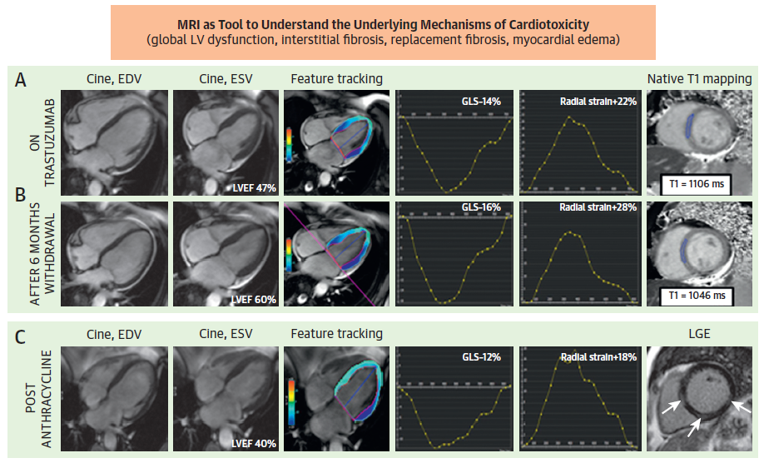
Cardiac Magnetic Resonance
LEFT VENTRICLE (LV) DYSFUNCTION
Differential diagnosis
Ischemia
Infiltrative disease
Myocarditis
Stress induced cardiomyopathy
Sepsis
Cancer-treatment related cardiotoxicity
Plana JC et al, JACC Cardiovasc Imaging. 2018
Notes:
However, its main strength is the capability to accurately detect LV dysfunction. CMR can identify small changes in LVEF. It can be used when a more reliable and precise measurement is needed to inform decisions. This is of vital importance for timely detection of cardiotoxicity, to start cardioprotective medications, and to safely continue cancer therapy. CMR can also clarify the exact etiology of LV dysfunction.

Slide 8
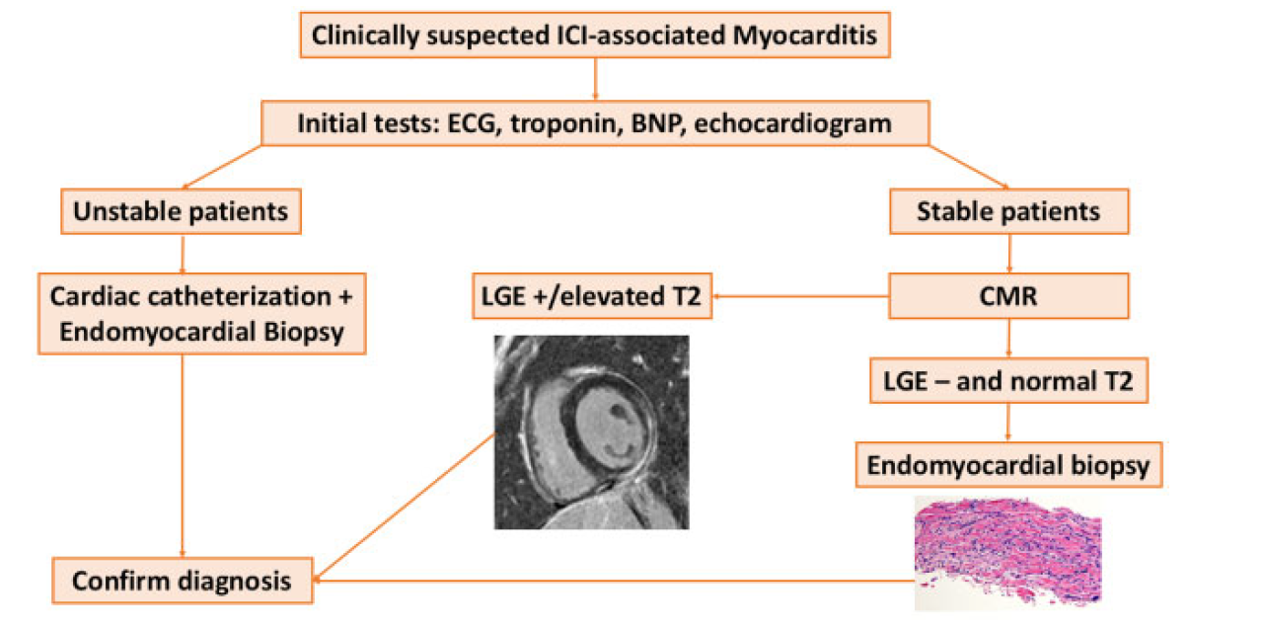
Cardiac Magnetic Resonance
MYOCARDITIS (stable patients)
LV systolic function
Strain analysis
Updated Lake Louise Criteria
T1 mapping
T2 mapping
Late gadolinium enhancement
Zhang L et al, Eur Heart J. 2020
Notes:
Myocarditis is a possible complication during cancer therapy. Myocarditis related to immune checkpoint inhibitors can be fatal. The diagnosis of myocarditis by CMR is made using the updated Lake Louise criteria which includes T1 and T2 mapping and LGE sequences.

Slide 9
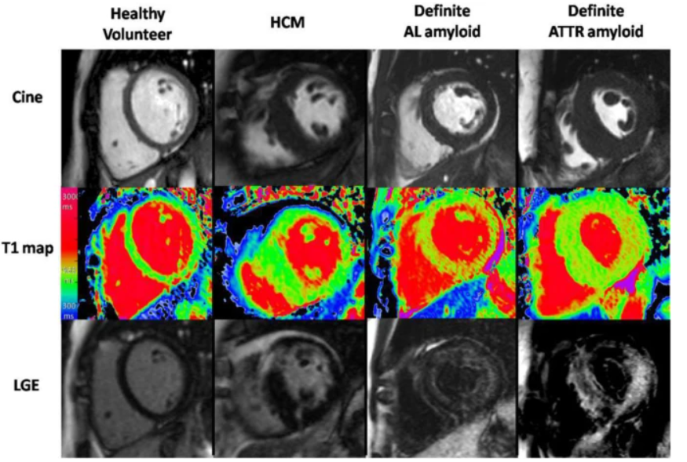
Cardiac Magnetic Resonance
INFILTRATIVE CARDIOMYOPATHY:
AMYLOIDOSIS
Cine images: LV hypertrophy, preserved LV ejection fraction
T1 mapping: elevated T1 values
Late gadolinium enhancement: extensive subendocardial circumferential
Fontana et al, Journal of Cardiovascular Magnetic Resonance 2014
Notes:
Infiltrative cardiomyopathy with light-chain amyloid may develop in patients with multiple myeloma or monoclonal gammopathy of undetermined significance. In elderly patients, transthyretin cardiac amyloidosis can coexist with cancer. The typical CMR pattern includes an abnormal native T1 signal and the presence of late gadolinium enhancement (LGE).

Slide 10
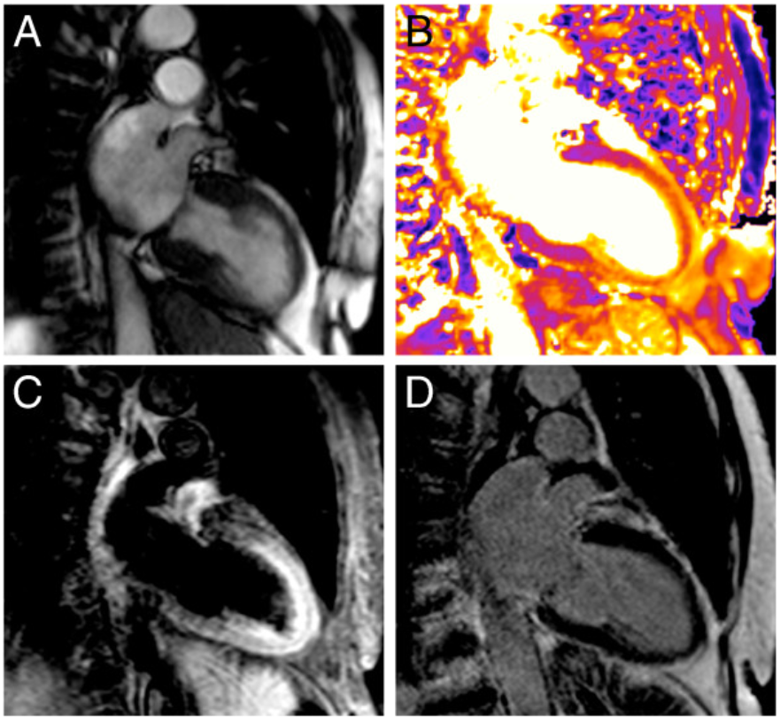
Cardiac Magnetic Resonance
STRESS CARDIOMYOPATHY
A – Cine images: apical ballooning
B – T2 mapping: edema in the apical segments
C – T2 STIR: edema in the apical segments
D – late gadolinium enhancement: absence of myocardial scar
Baldassarre LA et al, JACC. 2022
Notes:
Stress cardiomyopathy can occur in patients with cancer. CMR systolic cine frames reveal apical ballooning. Oedema in the apical segments in reflected in elevated T2 values and increased myocardial signal intensity in the apex. The absence of late gadolinium enhancement excludes myocardial scar.

Slide 11
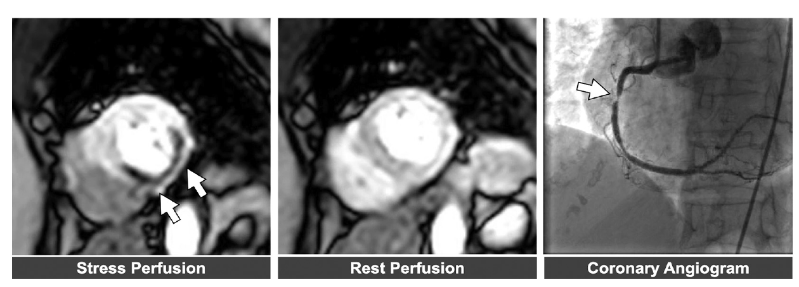
Cardiac Magnetic Resonance
ISCHAEMIA
Patel et al, JACC. 2021
Notes:
CMR is the most comprehensive imaging modality to evaluate for ischemia and viability. It can exclude conditions mimicking acute coronary syndrome, such as coronary vasospasm (ie, fluoropyrimidine cardiotoxicity), myocarditis (ie, ICI associated), or takotsubo cardiomyopathy.

Slide 12
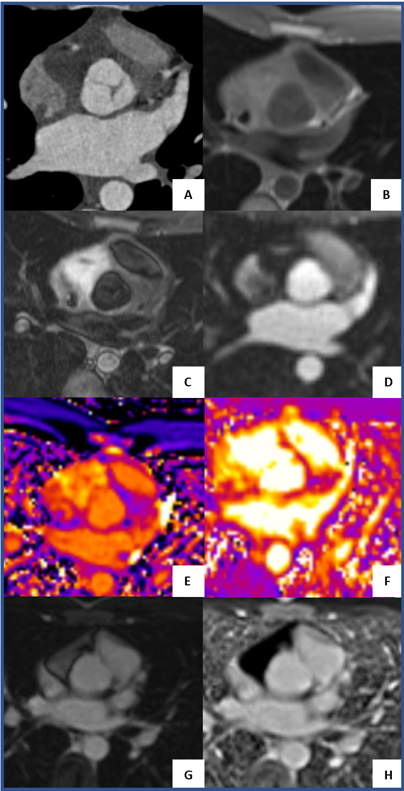
Cardiac Magnetic Resonance
CARDIAC MASSES
Differential diagnosis
Benign/malign tumor
Primary tumor/ metastasis
Thrombus
Multimodality imaging (Echocardiography, CMR, CT, PET)
CMR multiparametric imaging
T1 mapping
T2 mapping
Early/late gadolinium imaging
Rest perfusion
Baldassarre LA et al, JACC. 2022
Notes:
CMR occupies a niche in the evaluation and management of cardiac tumors. This patient from our center presented with a mass in the right side of the heart which was surgically excised. Multiple sequences helped in the differential diagnosis and surgical planning.

Slide 13
Cardiac Magnetic Resonance
Strengths
Superior image quality and resolution
Tissue characterization of the LV, pericardium and masses
Limitations
Cost and access
Prolonged scan time and extended breath-holds
Patients with significant claustrophobia
Contra-indications: metal devices, older cardiac devices
Motion, arrhythmia and device related artifacts
Notes:
Here are the strengths and limitations of this powerful technique. Compared with 2D echocardiography, CMR has higher reproducibility for LVEF assessment, because of higher image quality and resolution.
Tissue characterization of the LV, evaluation of the pericardium and masses are unique features.
Its disadvantages include its cost and accessibility, prolonged scan time and extended breath-holds. Claustrophobic patients may find it difficult. There are some contra-indications in patients with metal devices and older cardiac devices. Motion, arrhythmia and device related artifacts can deteriorate image quality.

Slide 14
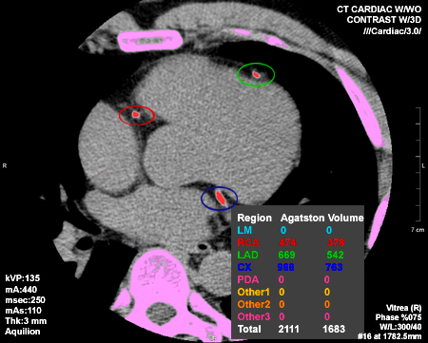
Cardiac CT
CORONARY ARTERY DISEASE
Coronary artery calcification (Calcium score): prior to cancer therapy or years after radiation therapy
Biersmith MA, JAHA. 2020
Notes:
Coronary artery calcium, CAC, has a fundamental role in the risk stratification of CV disease. It helps to assess baseline CV risk and during long term follow-up of cancer survivors after chest radiation therapy.

Slide 15
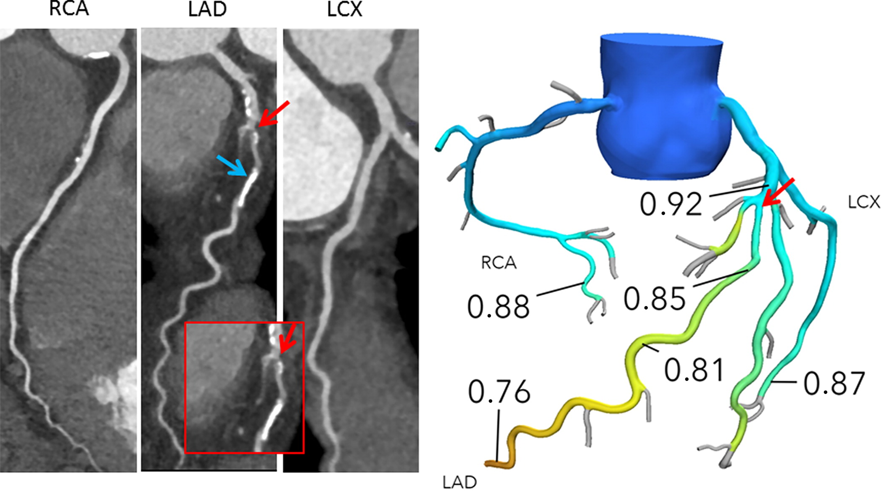
Cardiac CT
CORONARY ARTERY DISEASE
Stable coronary artery disease: total coronary artery plaque burden, severity and location
Rule out obstructive CAD as the aetiology of or contributor to decreased left ventricular systolic function
Rule out acute coronary syndrome: angina, myocardial ischemia, coronary vasospasm
Fractional flow reserve (FFRct): evaluation of functional significance of intermediate lesions from cardiac CT images
Lopez-Mattei JC, JACC CardioOncol. 2021
Notes:
Coronary CTA evaluates the coronary arteries anatomically in varied clinical situations and now physiological assessment is possible.
It can be a useful noninvasive method to exclude the presence of obstructive coronary artery disease in conditions such as 5-fluorouracil–associated vasospasm, ICI myocarditis, and takotsubo cardiomyopathy that can mimic acute coronary syndromes.

Slide 16
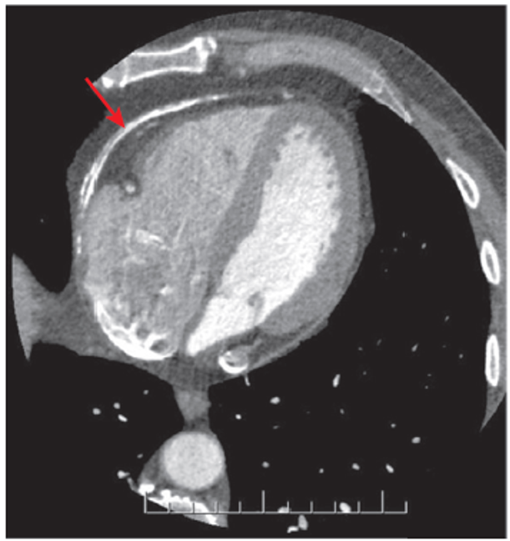
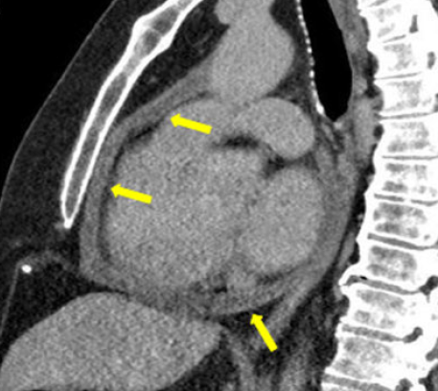
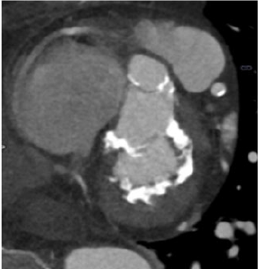
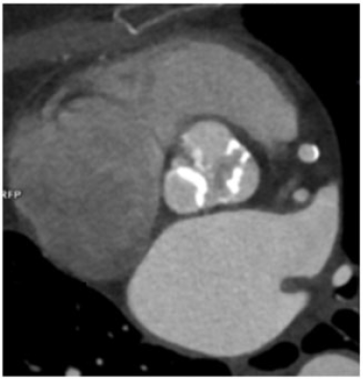
Cardiac CT
PERICARDIAL AND VALVULAR DISEASE
Biersmith MA. JAHA, 2020
Rosmini S. Eur Heart J Cardiovasc Imaging, 2021
Valvular heart disease: valvular calcification (aortic valve score) or structural intervention planning (eg. TAVR)
Pericardial disease: effusion, thickening or calcification
Cardiac tumor: location, relationship to and potential involvement of surrounding cardiac structures
Notes:
The pericardium and the valves are also evaluated well by CT because both these structures can be affected many years after radiation therapy.

Slide 17
Cardiac CT
Strengths
Rapid and readily available
Definitive evaluation of CAD with high negative predictive value
Noninvasive high-resolution anatomic evaluation
Calcium artery calcification on non-gated CT performed in cancer patients may identify previously unknown CAD
Limitations
Radiation exposure
Iodinated contrast may limit use in advanced renal insufficiency or contrast allergy
Significant calcification may preclude severity accurate assessment coronary lesions
Tachycardia and arrhythmia may limit image quality
Notes:
CT has its advantages and disadvantages.
CT is rapid and easily available and allows high-resolution anatomic evaluation of coronary artery disease with a high negative predictive value.
Calcium artery calcification on non-gated CT performed in cancer patients (eg. Cancer staging) may identify previously unknown CAD.
The limitations include radiation exposure and iodinated contrast administration. Significant calcification may preclude accurate assessment of coronary artery lesions and arrhythmias may limit image quality.

Slide 18
Multimodality Imaging
Take home messages
Cardiac magnetic resonance is a versatile imaging method that proficiently evaluates all cardiac structures that may be affected by cancer therapeutic agents.
Cardiac CT provides complimentary information and has a fundamental role in the anatomical evaluation of the coronary arteries.
Remarkable advances in the assessment of cardiotoxicity by these techniques have paralleled the development of newer therapies and improved prognosis in cancer patients.
Leveraging the strength of each imaging technique will fill our current gaps in knowledge and answer some of the unmet needs in a complex field that is growing exponentially.
Notes:
Advanced imaging techniques such as CMR and CT have shown remarkable advances in the assessment of cardiotoxicity keeping pace with development of newer therapies and improved prognosis in cancer patients. The techniques will fill our current gaps in knowledge and answer some of the unmet needs in a complex field that is growing exponentially.

Slide 19
Multimodality Imaging
Suggested Reading
Baldassarre LA, Ganatra S, Lopez-Mattei J, Yang EH, Zaha VG, Wong TC, et al; ACC Cardio-Oncology and the ACC Imaging Councils. Advances in Multimodality Imaging in Cardio-Oncology: JACC State-of-the-Art Review. J Am Coll Cardiol. 2022;80(16):1560-1578.
Saunderson CED, Plein S, Manisty CH. Role of cardiovascular magnetic resonance imaging in cardio-oncology. Eur Heart J Cardiovasc Imaging. 2021 Mar 22;22(4):383-396.
Rosmini S, Aggarwal A, Chen DH, Conibear J, Davies CL, Dey AK, Edwards P, Guha A, Ghosh AK. Cardiac computed tomography in cardio-oncology: an update on recent clinical applications. Eur Heart J Cardiovasc Imaging. 2021 Mar 22;22(4):397-405.
Lyon AR, López-Fernández T, Couch LS, Asteggiano R, Aznar MC, Bergler-Klein J, et al. 2022 ESC Guidelines on cardio-oncology developed in collaboration with the European Hematology Association (EHA), the European Society for Therapeutic Radiology and Oncology (ESTRO) and the International Cardio-Oncology Society (IC-OS). Eur Hear journal Cardiovasc Imaging. 2022;23(10):e333–465.

